Slide 1
linear list
A linear list is an ordered set consisting of a number of elements to which addition & deletion can be made. A linear list displays the relationship of physical adjency. The first element of a list is called the rear of list & the last is called the tail of the list. The next element of the head of the list is called it’s successor. The previous element to the tail (if it is not head of the list) is called it’s predessor. Clearly a head doesn’t have as predessor & a tail doesn’t have a successor. Any other element of the list has both one successor & one predessor.

Slide 2
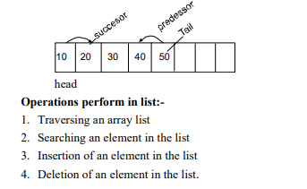

Slide 3
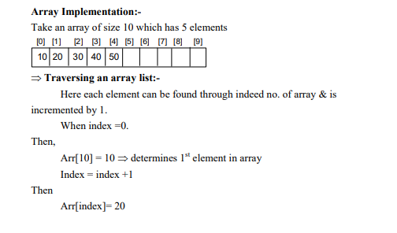

Slide 4
In this way we can transverse each element of array by incrementing the index by 1 until index is not greater than no. of elements.

Slide 5
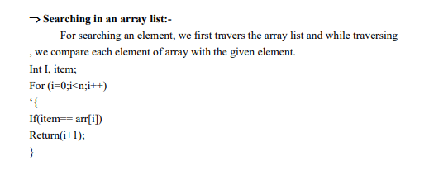

Slide 6
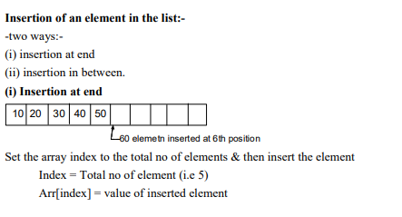

Slide 7
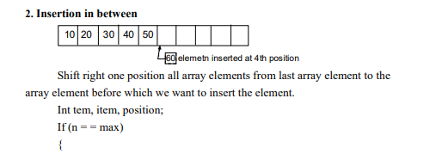

Slide 8
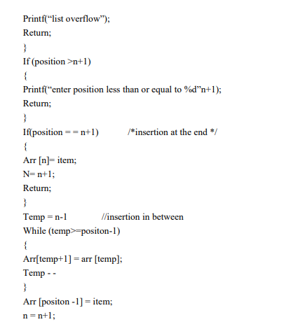

Slide 9
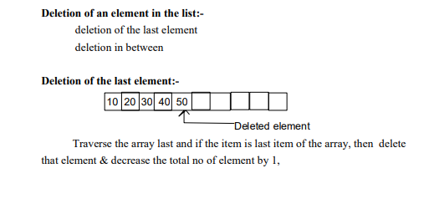

Slide 10
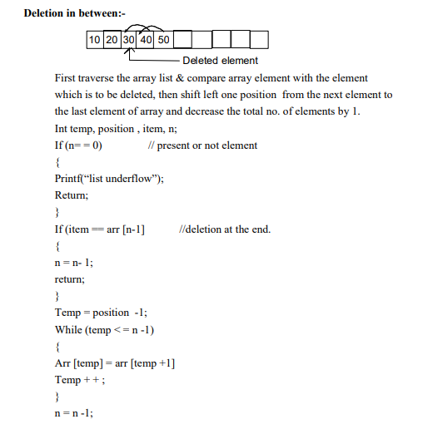

Slide 11
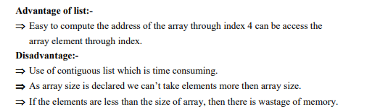

Slide 12
Dynamic memory allocation:-
In an array it is necessary to declare the size of array. This creates two possible problems.
If the records that are stored is less than the size of array, then there is a wastage of memory.
If we want to store more records then size of array, we can’t store.
To overcome these problem we use dynamic memory allocation. The functions used for dynamic memory
The functions used for dynamic memory allocation and deallocaton are :-
Malloc()
Calloc()
Free()
Realloc()

Slide 13
Malloc():-
This function is used to allocate memory space.
The malloc () function reserves a memory space of specified size and gives the strating address to the pointer variable
. Syntax:- Ptr = (data type * ) malloc (specified size)

Slide 14
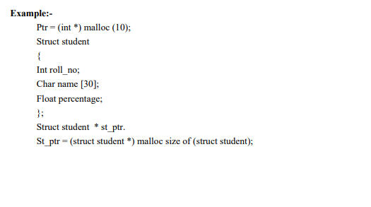

Slide 15
Calloc():-
The calloc () function is used to allocate multiple blocks of memory.
This has two arguments.
Syntax:- Ptr = (data type *) calloc (memory block, size )

Slide 16
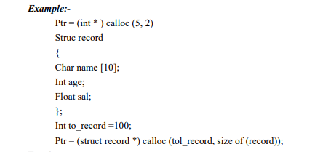

Slide 17
Free():-
This function is used to deallocate the previously allocated memory using mulloc () or calloc() function .
Syntax:- Free (ptr);

Slide 18
Realloc():-
This function is used to resize the size of memory block which is already allocated.
It is used in two condition.
⇒ If the allocated memory block is insufficient for current application.
⇒ If the allocated memory is much more than what is required by the current application.

Slide 19
